Slide 1



Artificial Intelligence
Local Search
ANWAR KHAN
University of Lahore

Slide 2

Local Search Algorithms
In this lecture:
Part 1: What/Why Local Search
Part 2: Hill-Climbing Search
Part 3: Simulated Annealing Search
Part 4: Genetic Algorithms

Slide 3
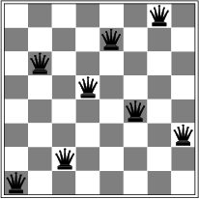
Local Search Algorithms
In many optimization problems, the path to the goal is irrelevant; the goal state itself is the solution.
ِExamples:
to reduce cost, as in cost functions
to reduce conflicts, as in n-queens
The idea: keep a single "current" state, try to improve it according to an objective function.
Local search algorithms:
Use little memory
Find reasonable solutions in large infinite spaces

Slide 4
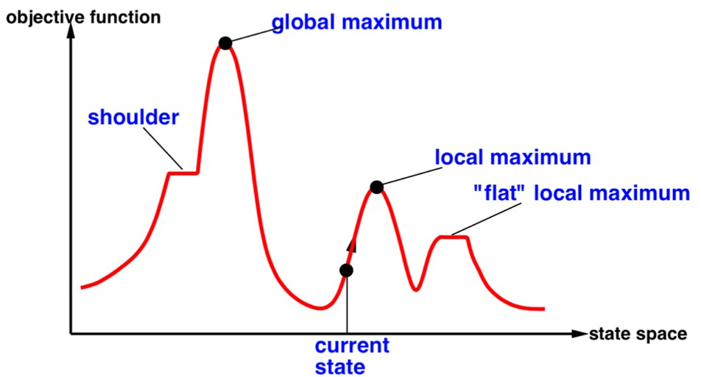
Local Search Algorithms
Terminate on a time bound or if the situation is not improved after number of steps.
Local search algorithms are typically incomplete algorithms, as the search may stop even if the best solution found by the algorithm is not optimal.

Slide 5
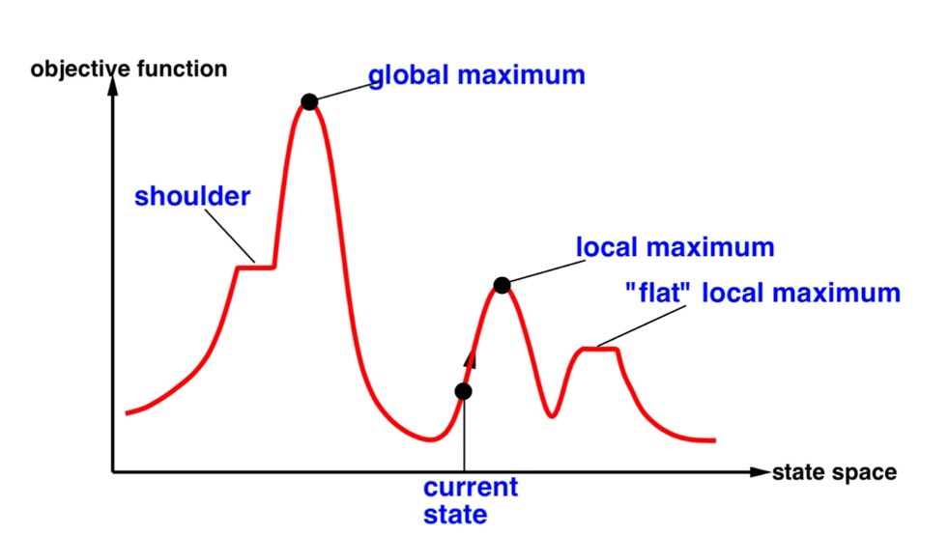
Search Landscape (two-dimension)

Slide 6
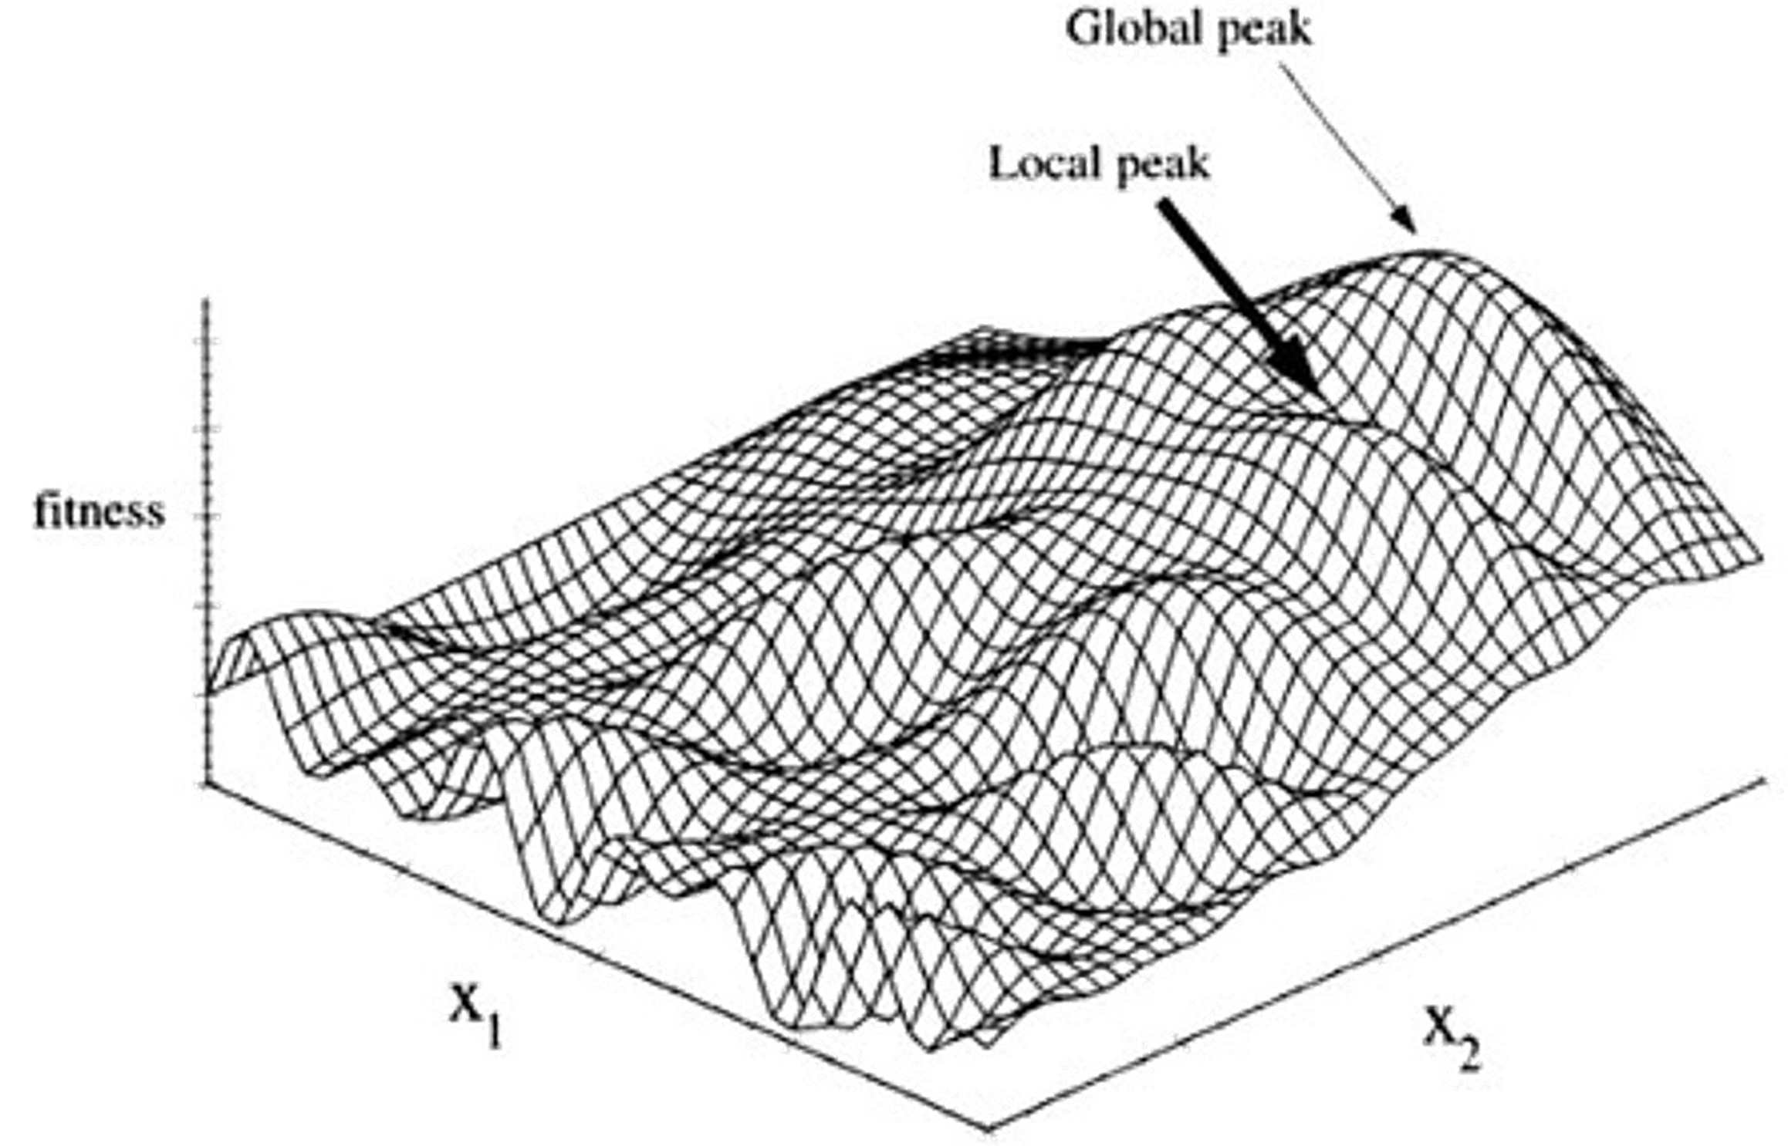
Search Landscape (three-dimensions)

Slide 7

Local Search Algorithms
In this lecture:
Part 1: What/Why Local Search Algorithms
Part 2: Hill-Climbing Search
Part 3: Simulated Annealing Search
Part 4: Genetic Algorithms in nutshell

Slide 8

Hill-Climbing Search
Continually moves in the direction of increasing value (i.e., uphill).
Terminates when it reaches a “peak”, no neighbor has a higher value.
Only records the state and its objective function value.
Does not look ahead beyond the immediate.
Sometimes called Greedy Local Search
Problem: can get stuck in local maxima,
Its success depends very much on the shape of the state-space land-scape: if there are few local maxima, random-restart hill climbing will find a “good” solution very quickly.

Slide 9
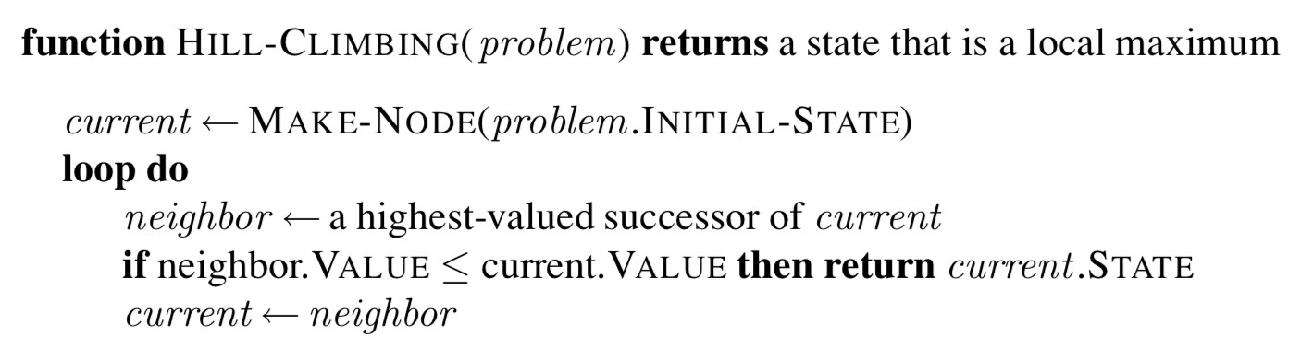
Hill-Climbing Search Algorithm
The hill-climbing search algorithm, which is the most basic local search technique. At each step the current node is replaced by the best neighbor; in this version, that means the neighbor with the highest VALUE, but if a heuristic cost estimate h is used, we would find the neighbor with the lowest h.

Slide 10
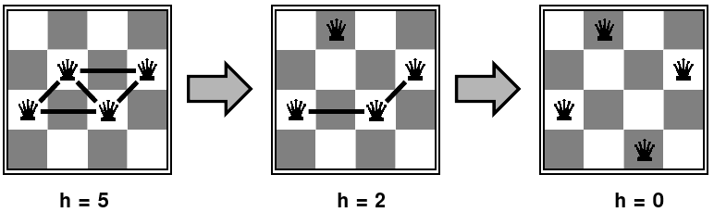
Example: n-queens
Put n queens on an n×n board with no two queens on the same row, column, or diagonal.
Move a queen to reduce number of conflicts.

Slide 11
Example: 8-queens
Key Rules & Objectives:
Board: A standard 8x8 chessboard.
Pieces: Eight queens.
Goal: Place all eight queens on the board.
Constraints:
  No Shared Rows: Each queen must be in a different row.
  No Shared Columns: Each queen must be in a different column.
  No Shared Diagonals: No two queens can be on the same diagonal line (up-left, up-right, down-left, down-right).

Slide 12
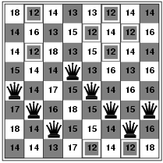
Example: 8-queens
Each number indicates h if we move a queen in its corresponding column
h = number of pairs of queens that are attacking each other, either directly or indirectly (h = 17 for the above state)

Slide 13
Example: n-queens
A local minimum with h = 1

Slide 14
Problems in Hill Climbing Algorithm
•
Local Maximum:
  A local maximum is a peak state in the landscape which is better than each of its neighboring states, but there is another state also present which is higher than the local maximum.
  Solution: Backtracking technique can be a solution of the local maximum in state space landscape. Create a list of the promising path so that the algorithm can backtrack the search space and explore other paths as well.

Slide 15
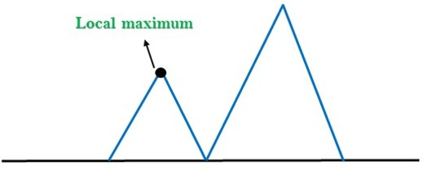
Problems in Hill Climbing Algorithm

Slide 16
Problems in Hill Climbing Algorithm
2. Plateau: A plateau is the flat area of the search space in which all the neighbor states of the current state contains the same value, because of this algorithm does not find any best direction to move. A hill-climbing search might be lost in the plateau area.
Solution: The solution for the plateau is to take big steps or very little steps while searching, to solve the problem. Randomly select a state which is far away from the current state so it is possible that the algorithm could find non-plateau region.

Slide 17
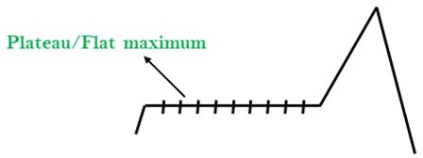
Problems in Hill Climbing Algorithm

Slide 18
Problems in Hill Climbing Algorithm
3. Ridges: A ridge is a special form of the local maximum. It has an area which is higher than its surrounding areas, but itself has a slope, and cannot be reached in a single move.
Solution: With the use of bidirectional search, or by moving in different directions, we can improve this problem.

Slide 19
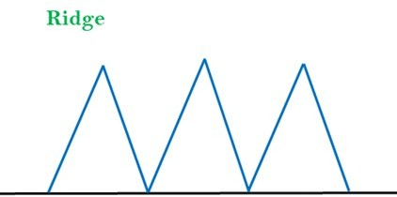
Problems in Hill Climbing Algorithm

Slide 20
Local Search Algorithms
In this lecture:
Part 1: What/Why Local Search Algorithms
Part 2: Hill-Climbing Search
Part 3: Simulated Annealing Search
Part 4: Genetic Algorithms in nutshell

Slide 21
Simulated Annealing
A hill-climbing algorithm which never makes a move towards a lower value guaranteed to be incomplete because it can get stuck on a local maximum.
And if algorithm applies a random walk, by moving a successor, then it may complete but not efficient.
Simulated Annealing is an algorithm which yields both efficiency and completeness.

Slide 22
Simulated Annealing
In mechanical term Annealing is a process of hardening a metal or glass to a high temperature then cooling gradually, so this allows the metal to reach a low-energy crystalline state.
The same process is used in simulated annealing in which the algorithm picks a random move, instead of picking the best move.
If the random move improves the state, then it follows the same path. Otherwise, the algorithm follows the path which has a probability of less than 1 or it moves downhill and chooses another path.

Slide 23
What Simulated Annealing does differently
Simulated Annealing sometimes accepts worse solutions, especially at the beginning.
It uses a probability rule:
        P=e−ΔE/T
ΔE = increase in cost (worse solution)
T = temperature

Slide 24
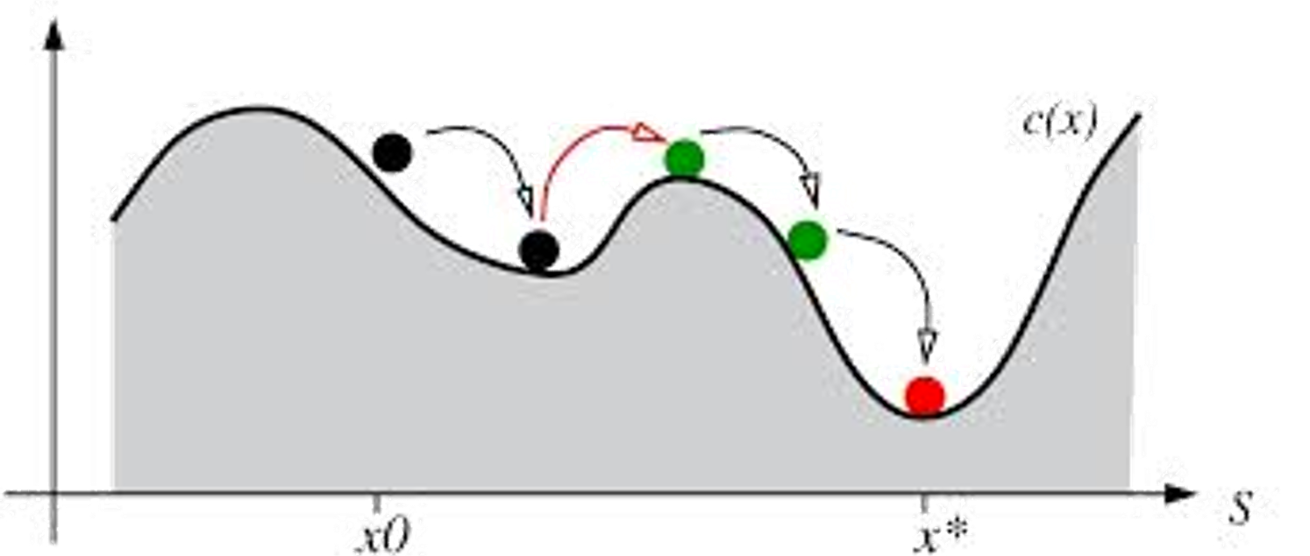
Simulated Annealing Search
To avoid being stuck in a local maxima, it tries randomly (using a probability function) to move to another state, if this new state is better it moves into it, otherwise try another move… and so on.

Slide 25
Simulated Annealing Search
Terminates when finding an acceptably good solution in a fixed amount of time, rather than the best possible solution.
Locating a good approximation to the global minimum of a given function in a large search space.
.

Slide 26
Properties of Simulated Annealing Search
The problem with this approach is that the neighbors of a state are not guaranteed to contain any of the existing better solutions which means that failure to find a better solution among them does not guarantee that no better solution exists.
It will not get stuck to a local optimum.
If it runs for an infinite amount of time, the global optimum will be found.

Slide 27
Local Search Algorithms
In this lecture:
Part 1: What/Why Local Search Algorithms
Part 2: Hill-Climbing Search
Part 3: Simulated Annealing Search
Part 4: Genetic Algorithms in nutshell

Slide 28
Genetic Algorithms
Inspired by evolutionary biology and natural selection, such as inheritance.
Evolves toward better solutions.
A successor state is generated by combining two parent states, rather by modifying a single state.
Start with k randomly generated states (population), Each state is an individual.

Slide 29
Genetic Algorithms
A state is represented as a string over a finite alphabet (often a string of 0s and 1s)
Evaluation function (fitness function). Higher values for better states.
Produce the next generation of states by selection, crossover, and mutation.
Commonly, the algorithm terminates when either a maximum number of generations has been produced, or a satisfactory fitness level has been reached for the population.

Slide 30
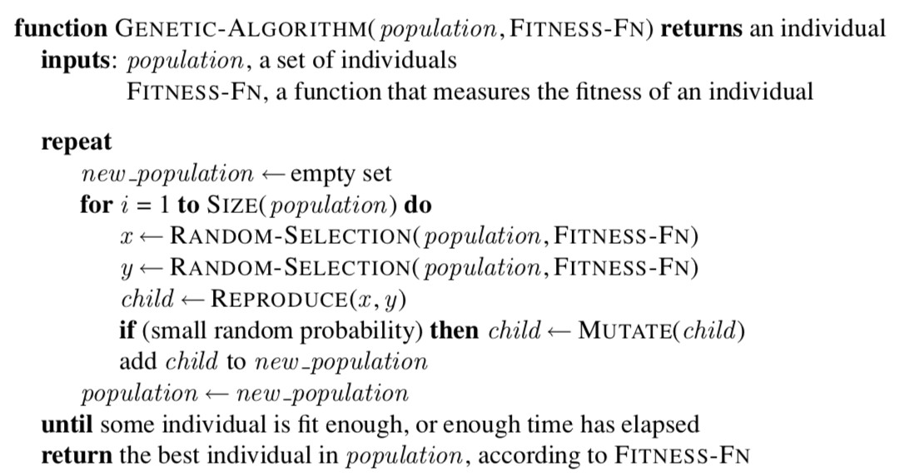
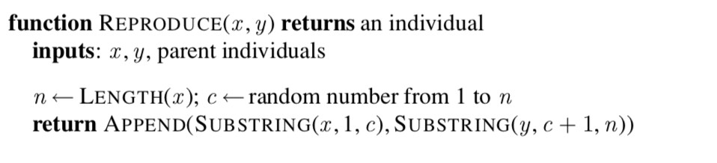
Genetic Algorithms

Slide 31
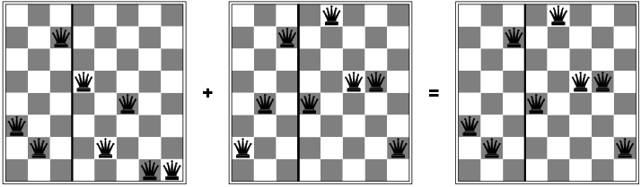
The 8-queen Problem
Try to better position the queens using the genetic algorithm. A better state is generated by combining two parent states.
The good genes (features) of the parents are passed onto the children.

Slide 32
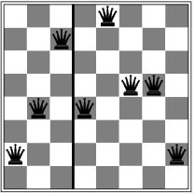
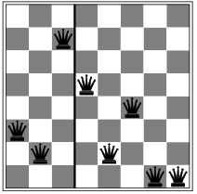
The 8-queen Problem
Represent individuals (chromosomes) :
Can be represented by a string digits 1 to 8, that represents the position of the 8 queens in the 8 columns.
24748552
32752411
.
.
24415124
.
32543213

Slide 33
The 8-queen Problem
Fitness Function :
Possible fitness function is the number of non-attacking pairs of queens. (min = 0, max = 8 × 7/2 = 28)
24
24748552
23
32752411
20
.
.
24415124
11
.
32543213

Slide 34
The 8-queen Problem
Fitness Function :
Calculate the probability of being regenerated in next generation. For example: 24/(24+23+20+11) = 31% , 23/(24+23+20+11) = 29% , etc.
24
24748552
31%
23
32752411
29%
20
24415124
.
.
.
26%
11
32543213 14%

Slide 35
The 8-queen Problem
Selection:
Pairs of individuals are selected at random for reproduction w.r.t. some probabilities. Pick a crossover point per pair.
24
24748552
31%
3275 | 2411
2474 | 8552
23
32752411
29%
20
24415124
.
.
.
26%
327524 | 11
244151 | 24
11
32543213 14%

Slide 36




The 8-queen Problem
Crossover
A crossover point is chosen randomly in the string. Offspring are created by crossing the parents at the crossover point.
24
24748552
31%
3275 | 2411
2474 | 8552
32748552
23
32752411
29%
24752411
20
.
.
.
24415124
26%
327524 | 11
244151 | 24
32752124
11
32543213 14%
24415411
28

Slide 37
The 8-queen Problem
Mutation
Each element in the string is also subject to some mutation with a small probability.
24
24748552
31%
3275 | 2411
2474 | 8552
32748552
327481 |  | 52
23
32752411
29%
24752411
24752411
20
.
.
.
24415124
26%
327524 | 11
244151 | 24
32752124
32 | 25 | 2124
11
32543213
14%
24415411
24415417

